Slide 1
Search Engine Optimization

Slide 2
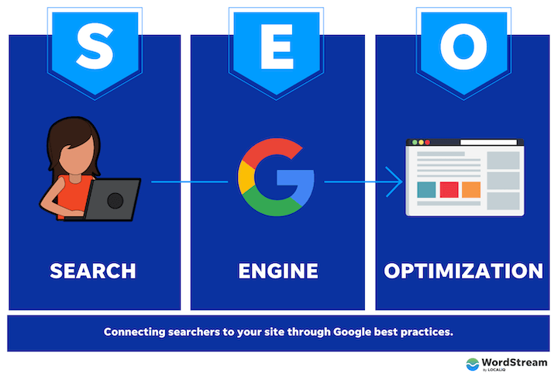
Why is SEO Important?
Search Engine Optimization (SEO) helps your website to appear higher in search engine results pages (SERPs) for relevant search queries.
When people search for something online, they usually only click on the first few results that appear on the SERP. So if your website isn't ranking high in the search results, you're missing out on potential traffic and customers.
By optimizing your website for SEO, you can improve your chances of appearing higher in the search results, which can lead to more traffic and ultimately more business.
This process involves optimizing your website's content, structure, and coding to make it more visible and relevant to search engines.

Slide 3
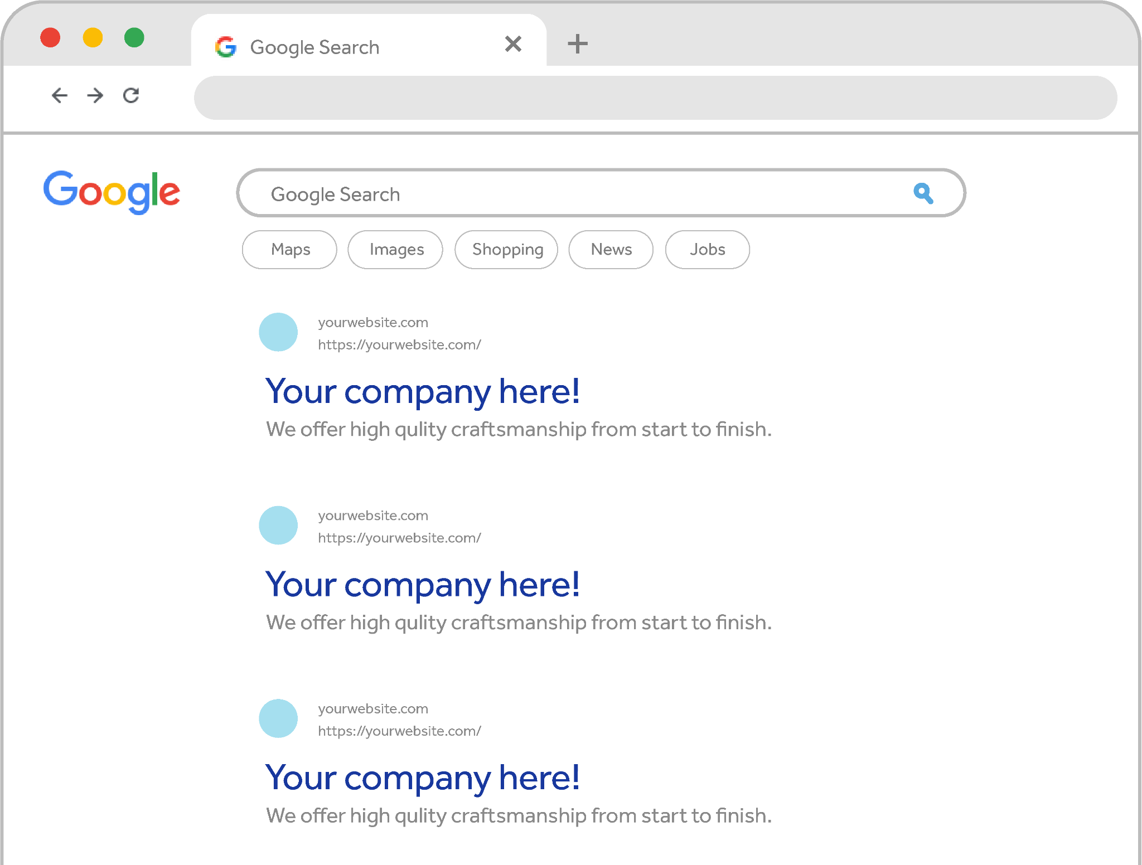
What is SEO?
Think of SEO like
paying rent to Google
to have your website appear in a certain spot on a search results page.
You should view SEO as a business expense, rather than a marketing expense.
Notes:
ANALOGY: paying rent for page 1 on Google Search Engine Results Page

Slide 4
Search Engine Optimization is an encompassing approach to optimize your entire web presence for organic search including your website, social channels, blogs, and directory listings.
We use strategies, techniques and tactics to increase the quality and quantity of organic search traffic to your website with a strong emphasis on content marketing and website performance.
Our SEO services include:
On-Site SEO: Keyword Research, Web Hosting, Google Analytics setup w/ conversion tracking, Internal link building, Proper set-up of meta tags and alt tags, Unique and keyword focused content
Off-Site SEO: Directory Listing Management & Link Building
Helping People Find Your Website

Slide 5
Client Spotlights
German Auto
Repair Shop
Personal & Business Insurance Agency

Slide 6
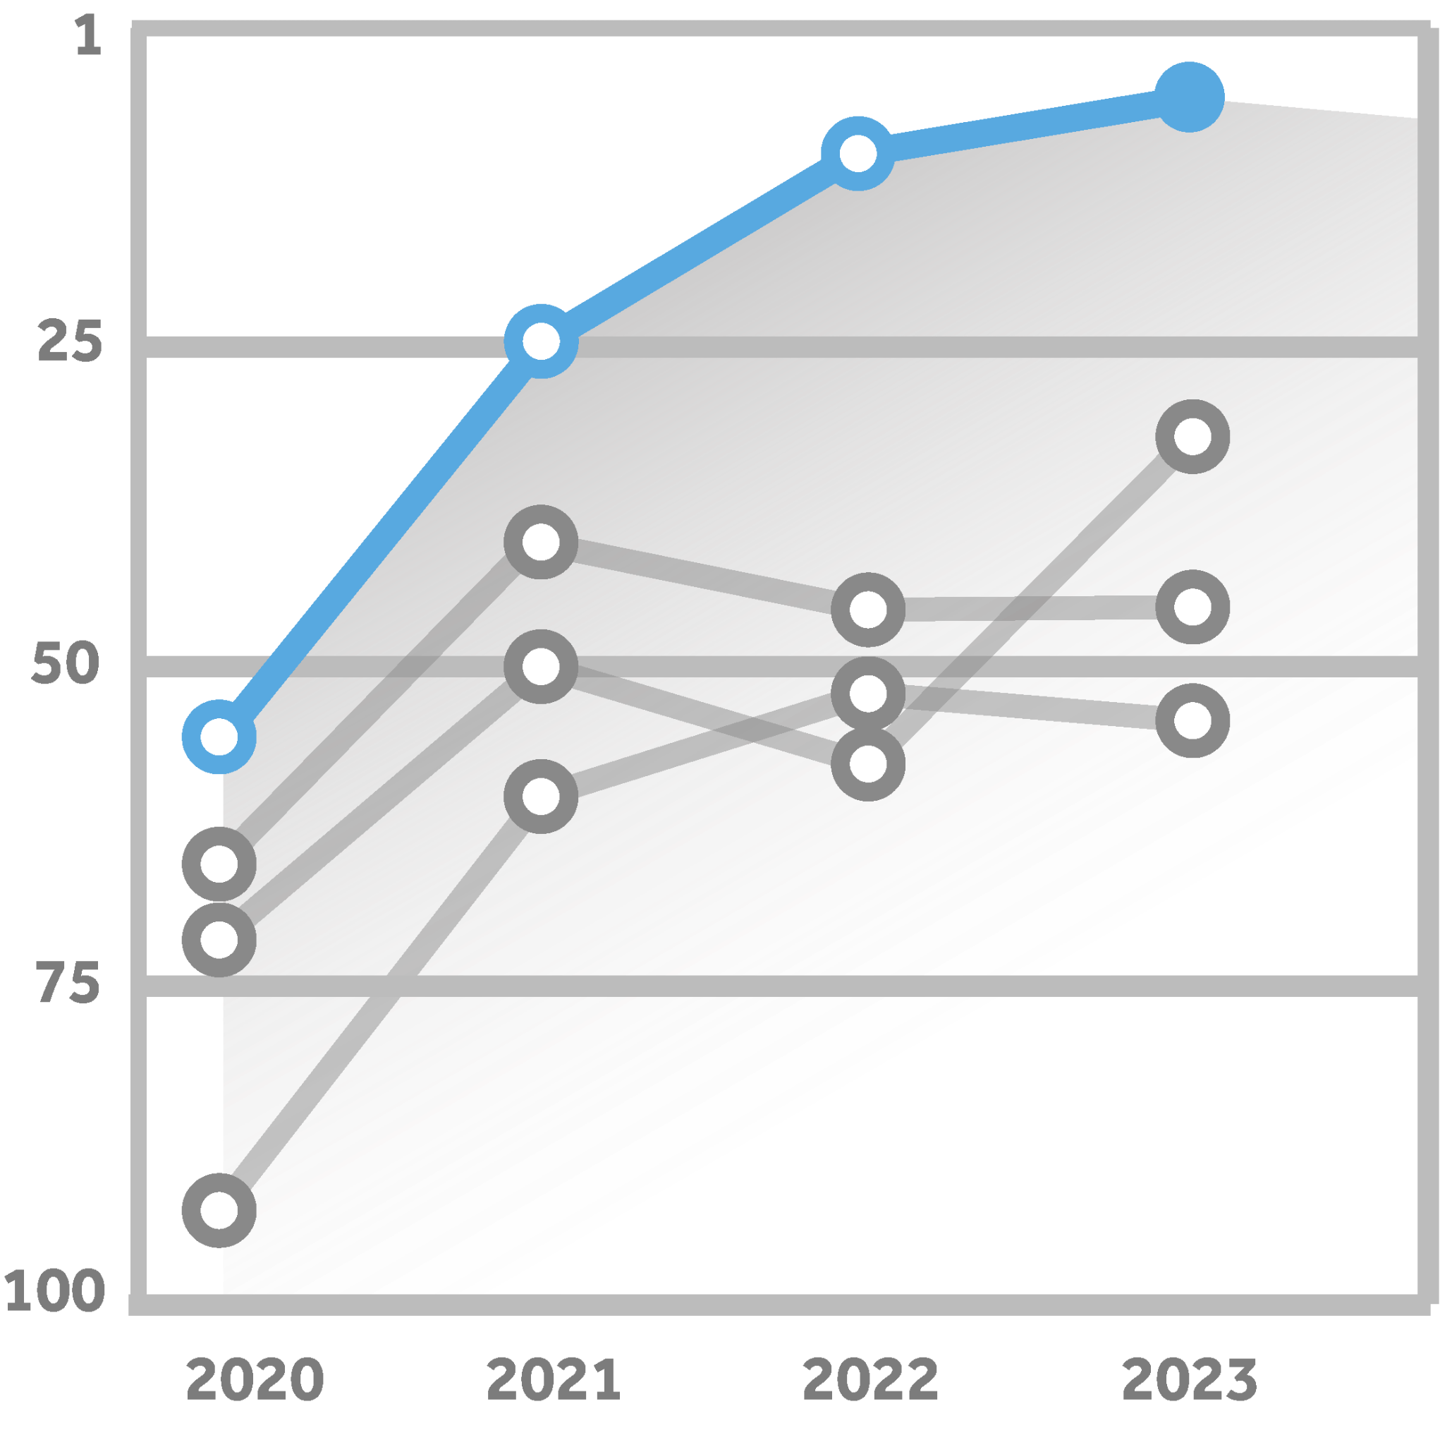
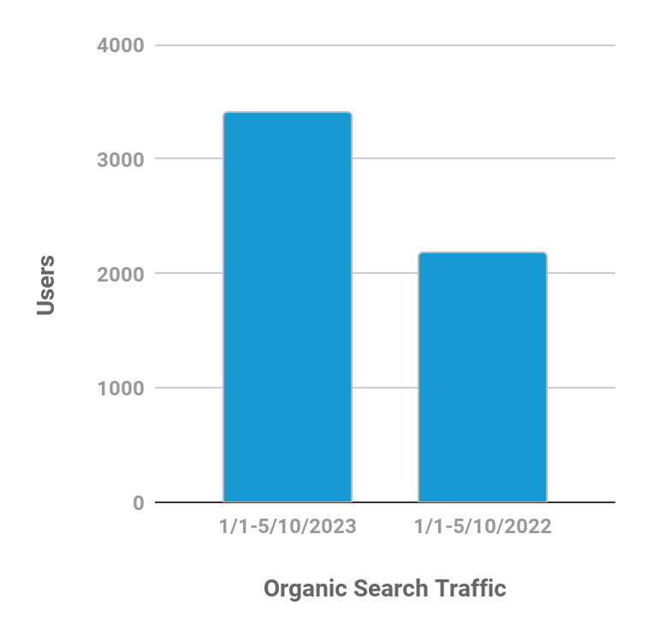
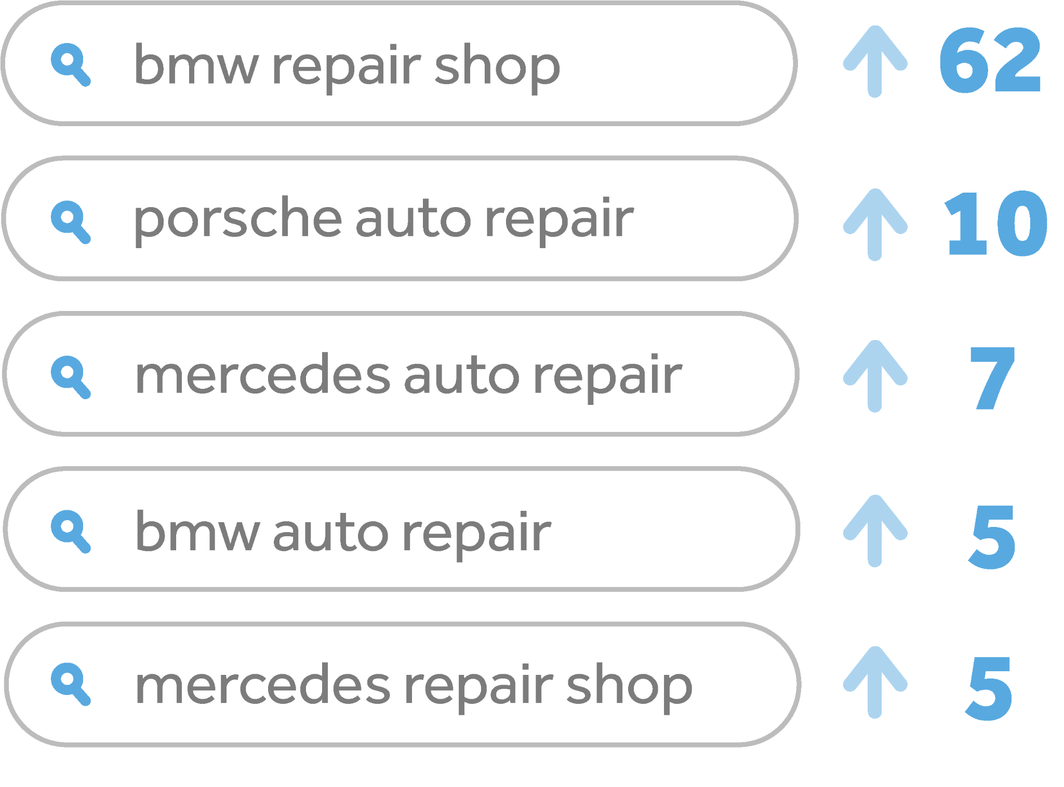
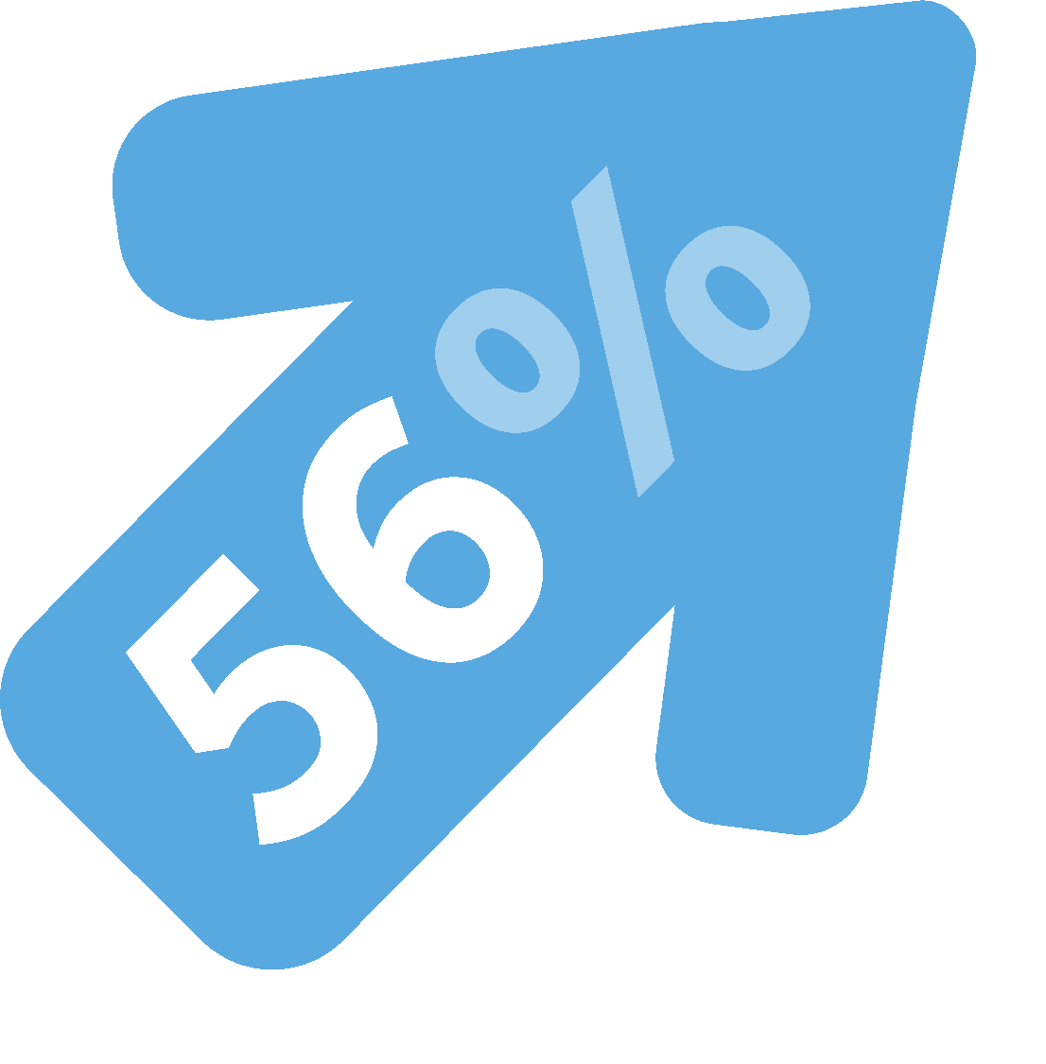
Ottohaus Statistics
MOST
IMPROVED KEYWORDS
100%
48%
56%
INCREASE
INCREASE
INCREASE
In average keyword position compared to client’s competitors
In organic search traffic over last 12 months
Of Keywords on Page 1 of Google
Over last
12 months

Slide 7
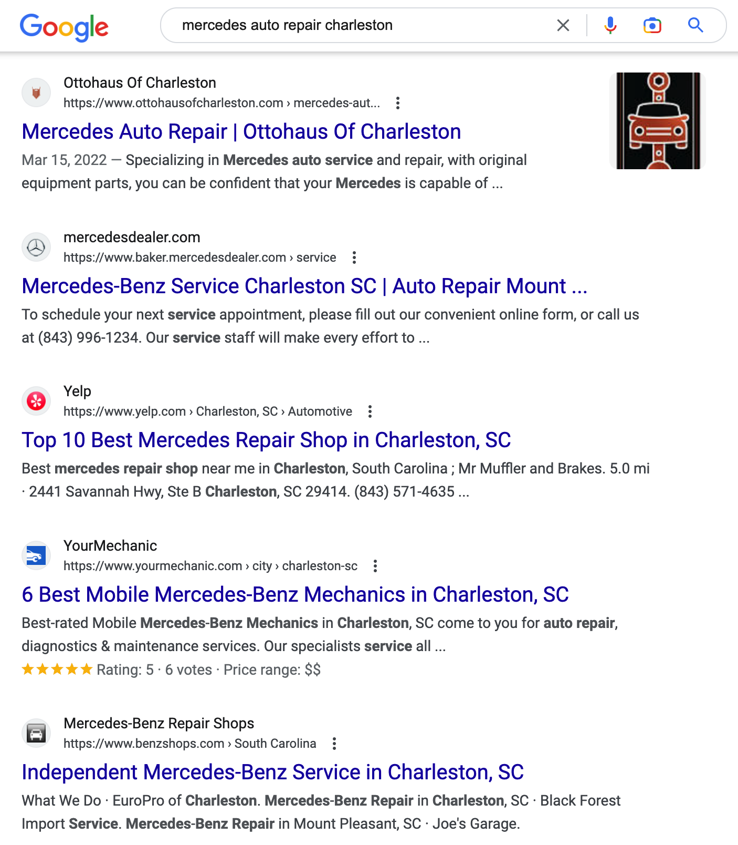
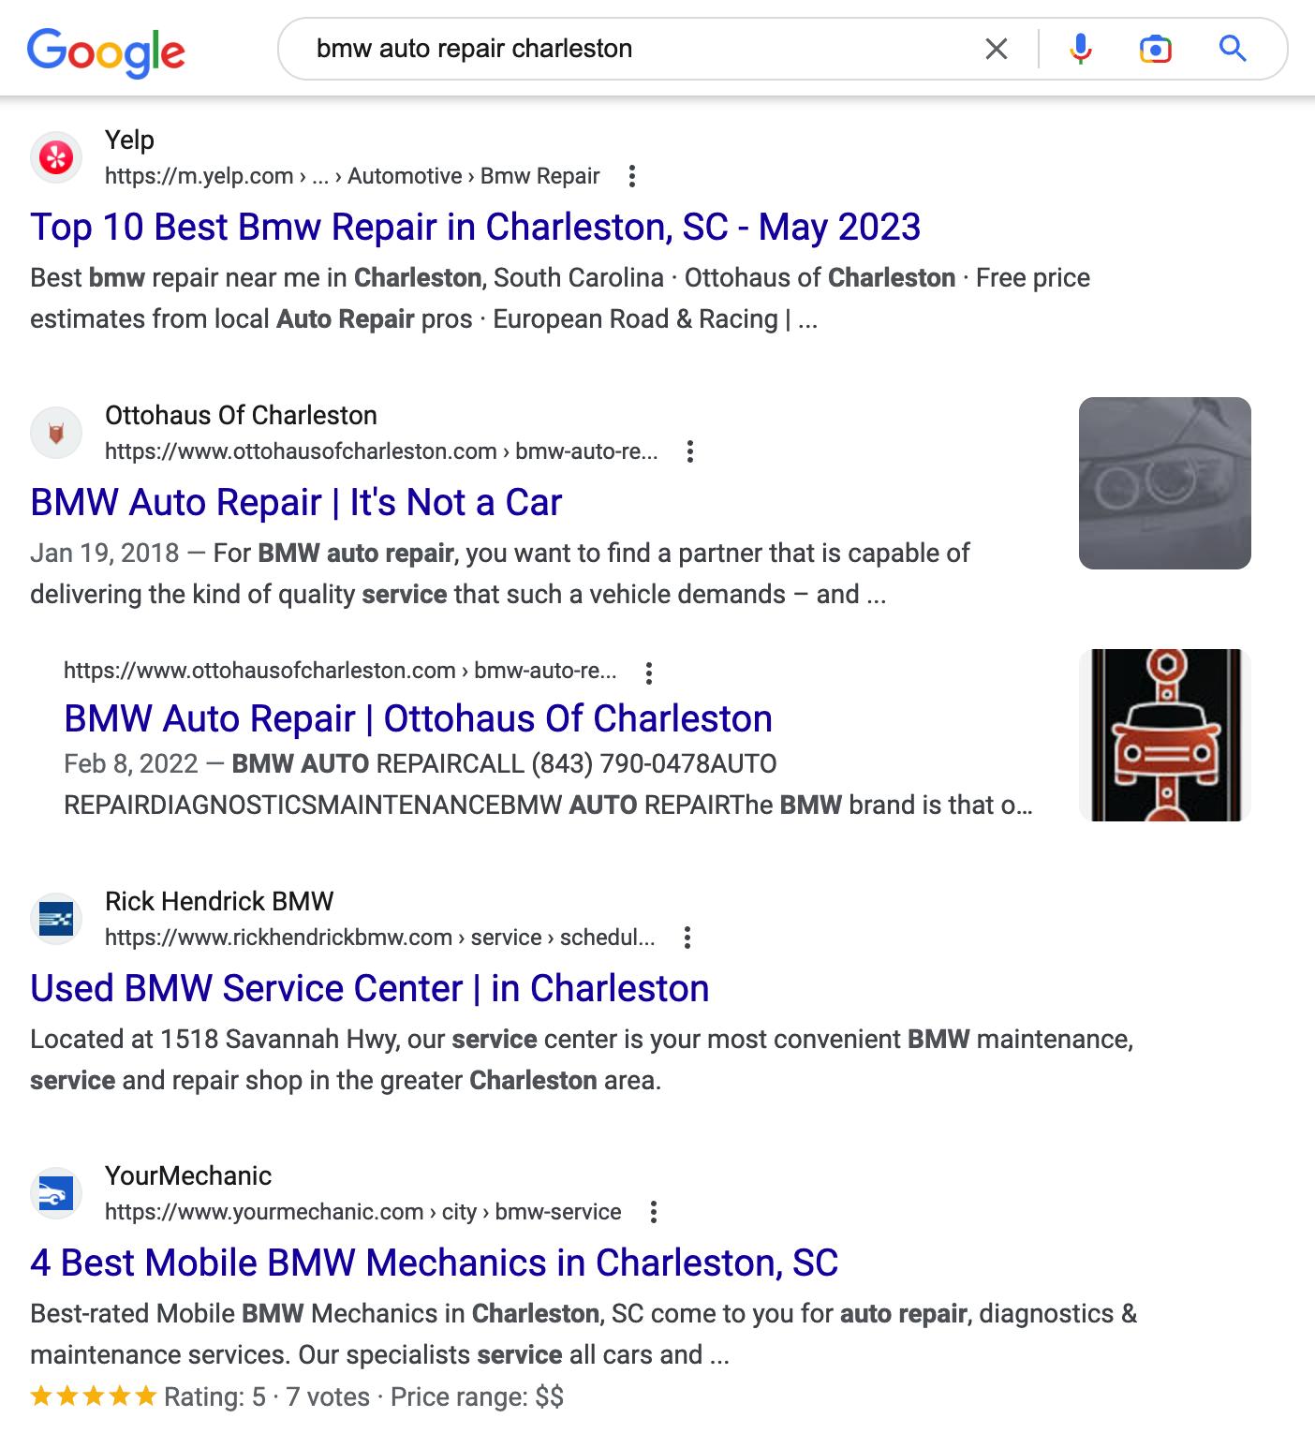
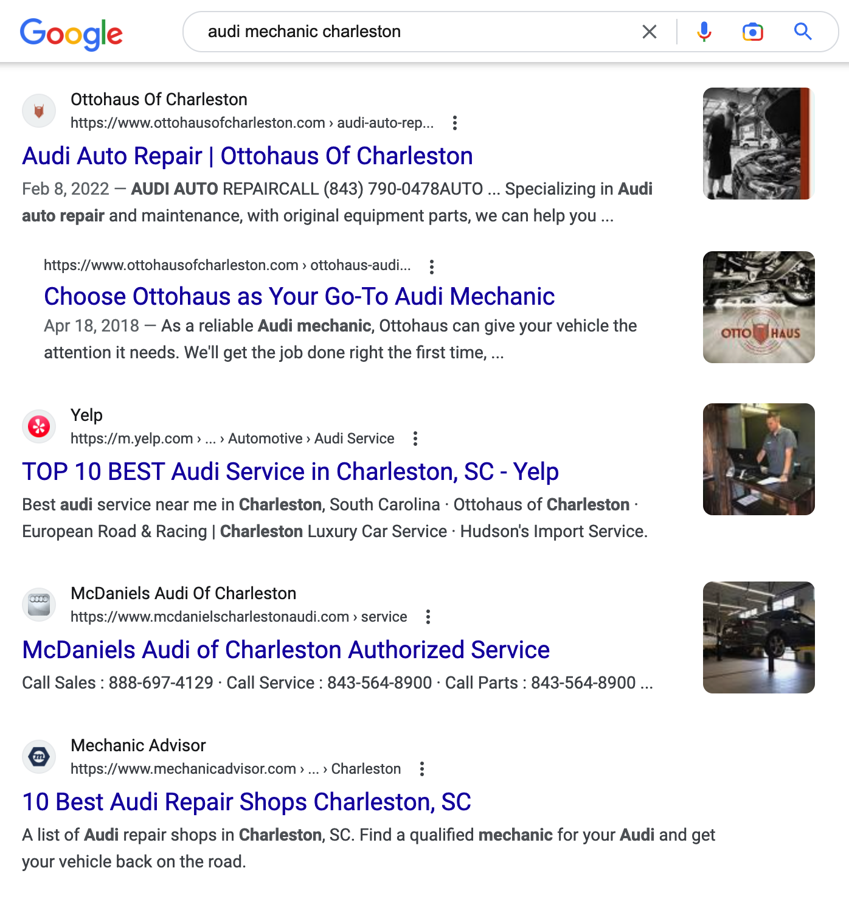
Results
Position 1
“Mercedes auto repair Charleston”
Position 2
“BMW auto repair Charleston”
Position 1
“Audi mechanic Charleston”

Slide 8
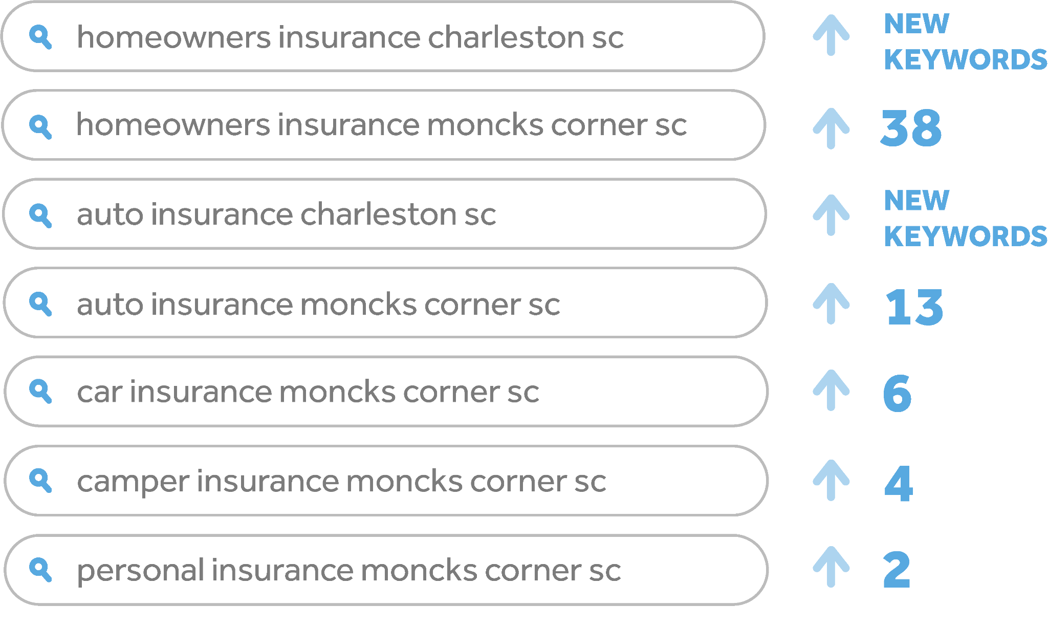
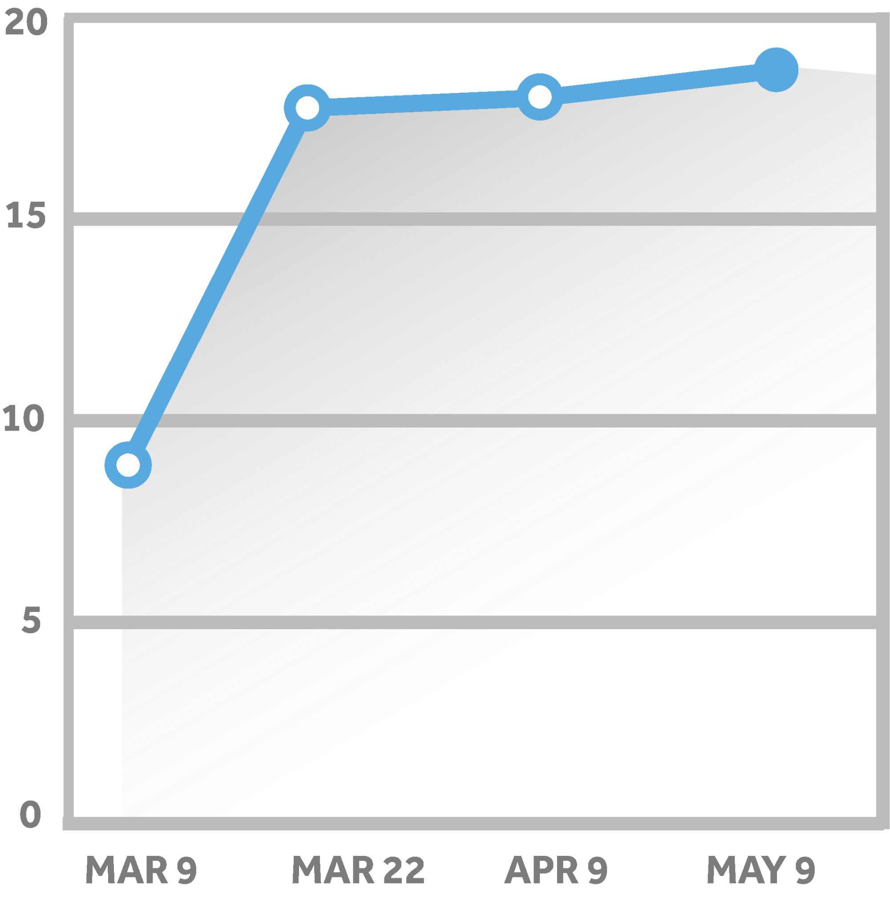
Swamp Fox Agency Statistics
110%
28%
MOST IMPROVED KEYWORDS
INCREASE
INCREASE
Of Keywords on Page 1
of Google
In organic search traffic over last 60 days
Over last 60 days

Slide 9
SEO Packages & Pricing

Slide 10
SEO
 | Local | Regional | Premier
Pricing (Per Month) | $1,800 | $2,400 | $3,600
Number of Key-phrases Optimized | 15 | 25 | 40
Short-form content (300 words) | up to 3/month | up to 4/month | up to 5/month
Basic website updates | 3 revisions/mo | 5 revisions/mo | 8 revisions/mo
Additional website pages | $500/page | up to 1 page/mo | up to 2 pages/mo
*Web hosting on dedicated server | ✓ | ✓ | ✓
Key-phrase research and selection | ✓ | ✓ | ✓
Meta tags (title & description) | ✓ | ✓ | ✓
Optimization of robots.txt & GoogleBot crawls | ✓ | ✓ | ✓
Creation & registrations of sitemap.xml | ✓ | ✓ | ✓
GA4 setup w/ conversion tracking & traffic analysis | ✓ | ✓ | ✓
Page speed optimization | ✓ | ✓ | ✓
Custom 404 error page setup & optimization | ✓ | ✓ | ✓
Updating core files & database | ✓ | ✓ | ✓
Internal Link Building | ✓ | ✓ | ✓
Customized monthly reporting | ✓ | ✓ | ✓
Directory Listing Management | ✓ | ✓ | ✓
Web lead phone call tracking |  | ✓ | ✓
Mobile site optimization (if applicable) |  | ✓ | ✓
Schema HTML tags |  | ✓ | ✓
Searcher experience analysis (heat map) |  |  | ✓
Channel specific call tracking |  |  | ✓
Search Engine Optimization
Plans & Pricing
Committing to authentic SEO requires a long-term approach that demands time and effort to achieve and maintain a high ranking. It is an achievable goal and the key to success lies in developing a solid plan and consistently implementing it to keep your website optimized and up-to-date.
SEO contracts are 12 months.
Month 1 is Set Up; Month 2-12 program execution.
*Web Hosting Included With SEO Contract.
$99/month (net) / $149/month (gross) for all non-SEO Contracts

Slide 11
Thank You!

