Slide 1
[Client Logo]
[Client Name]
[Campaign Name]
[Campaign Date Range]

Slide 2
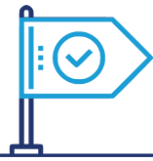
CAMPAIGN GOALS
General Brand Awareness
Discoverability
Lead Generation

Slide 3
RECOMMENDATIONS

Slide 4
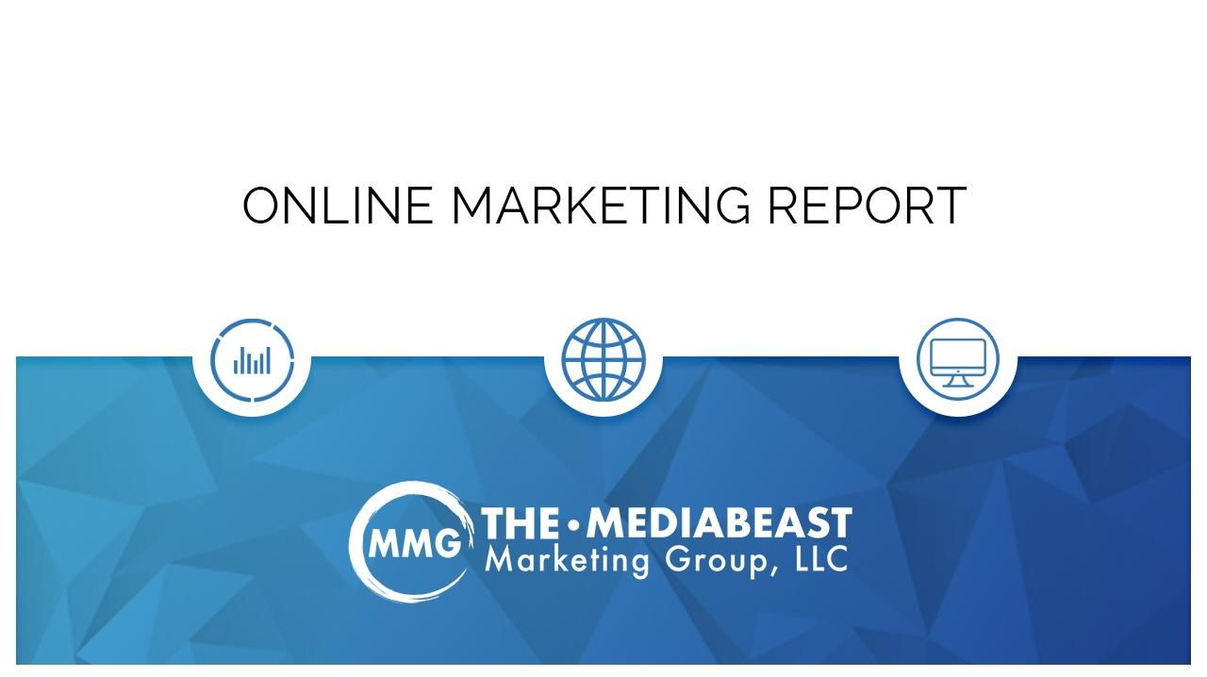
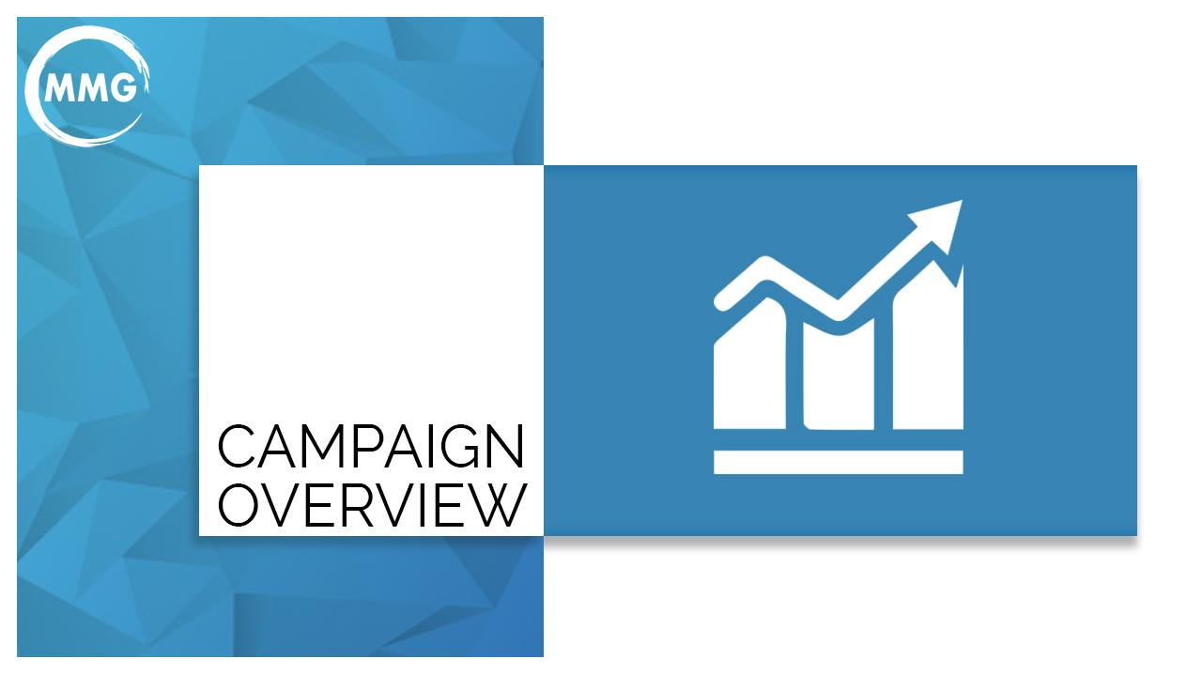
WHAT’S THE DIFFERENCE?
How Do They Work Together?
SEARCH ENGINE OPTIMIZATION (SEO) | SEARCH ENGINE MARKETING (SEM)
Organic Results | Paid Ads
Google Revenue: $0 | Google Revenue: +72% (Over $162 billion in 2022)
Long Term Strategy | Immediate Gratification
KPIs: Keyword Rankings & Organic Traffic | KPIs: Conversions & Cost Per Lead
Represents majority of the traffic to website | Bonus Impressions: Only pay when someone clicks your AD
2020
Monthly Performance Report
Notes:
Maggie
INSTANT GRATIFICATION
Why they work well together

Slide 5
SEM/PPC

Slide 6
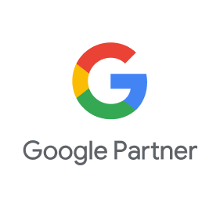
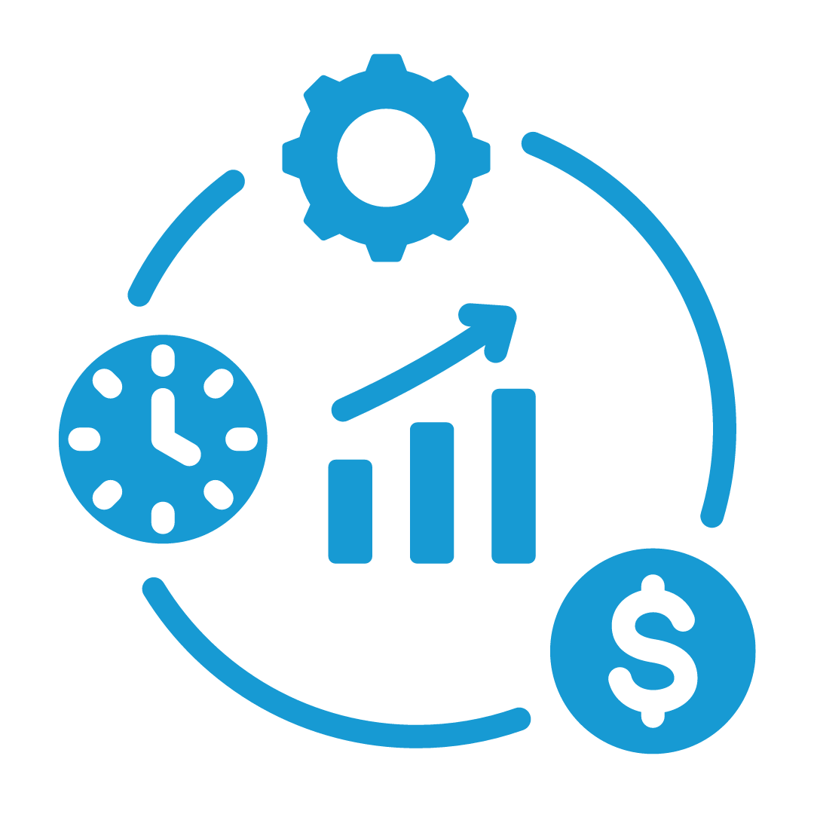
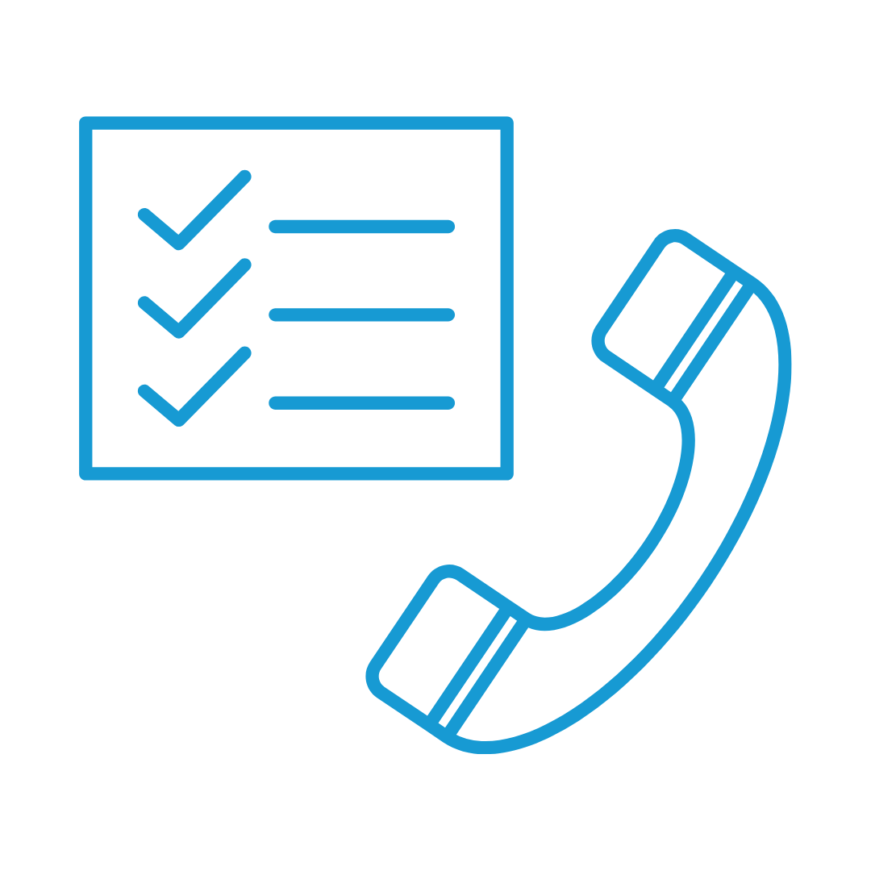
SEM/PPC Services
5-Star Rated
Google Partner
90% Client
Retention Rate
Conversion Based Campaigns
Dedicated Account Campaign Managers
Weekly Account Optimizations
Reporting & Dashboard
Call Tracking
Monthly Reports with Highlights, Opportunities, & Challenges
Attribution, Spot Checking, Missed Call Reporting, etc.
Keywords, Search terms, Ad copy, etc.
Notes:
Focused on building trust with clients - 90% Retention Rate
Goal is to see this same retention rate for fulfillment accounts
More renewals, less time pitching/selling, recurring commission for AEs
Sales Training & Support -
help you learn more about SEO and if not currently comfortable talking about, gain confidence to have conversations with prospects and current radio clients
our resource center has tons of great resources
Dedicated Account Campaign Managers -
Google certified
same team members every time
In-depth Monthly Report with Highlights, Opportunities, & Challenges
Common scenario: prospects have an existing SEO vendor, NOT getting any reporting
We’re setting you up for success to build trust with client to increase retention

Slide 7
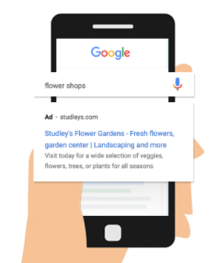
Searched Engine Marketing / PPC
More than 60% of website traffic starts with a search engine query. Pay-Per-Click (PPC) puts your brand at the top of search results for queries relevant to your brand and audience. This valuable advertising real estate can provide an immediate source of targeted traffic to your website, driving conversions and contributing to revenue growth.
Our PPC Services Include:
PPC Strategy Development
PPC Research
Campaign Setup
Turnkey PPC Campaigns
PPC Optimization
We have extensive experience leveraging PPC to drive growth for our clients. Our approach to PPC is data-driven, which allows us to deploy campaigns that focus on efficiency and constant improvement.
Get The Results That Matter To You:

Slide 8
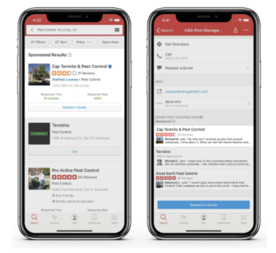
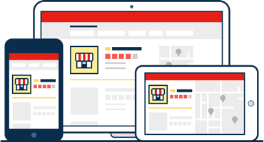
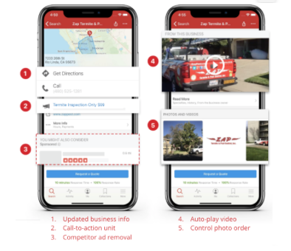
Yelp Ads
Yelp’s top priority remains connecting consumers with great local businesses
1.
Reach your customers on Yelp with two products:
Search Advertising
Yelp Ads Appear:
Above search results
On competitors’ pages
Benefits of Yelp Ads:
Increase visibility and reach
Drive more traffic to your website
More qualified leads
2.
Enhanced Profile
Brand Consistency
Control Photo Content
Complimentary Video Hosting
Highlight new items or specials with call to action unit
Focus potential customers on you by removing competitor ads

Slide 9
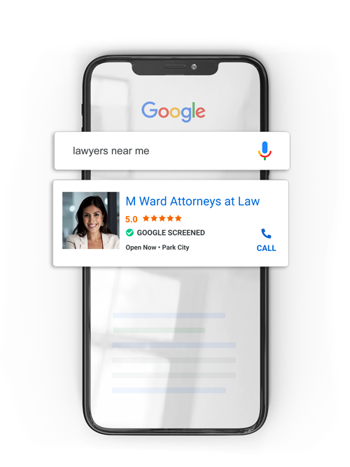
Local Service Ads
Get More Leads and Grow Your Business
Local Services Ads help you connect with local customers who search for the services you offer. Your ads will show up at the right time, and you only pay when a customer contacts you directly through the ad.
Earn Customers Trust With A Google Badge
Verify your business by letting Google run a license and insurance check, and earn a Google badge of trust to put on your ad which gives you extra credibility and gives customers more confidence to book your services.
Set Your Budget and Only Pay For Results
Choose a budget based on the number of new leads you want every week, and pause your ads when you’re booked up or away. Not sure where to start? We can use our budget tool to help you decide on a budget.
*Only available for certain industries

Slide 10
Website
Design & Development

Slide 11
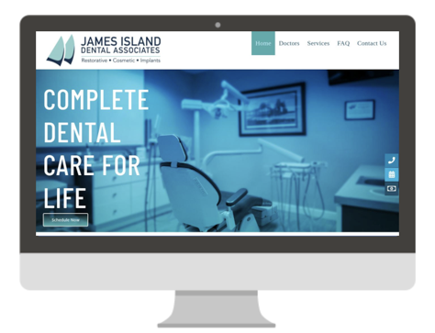
Website Design and Development
We hold one goal above all others: 100% client satisfaction. Our in-house team of web designers, copywriters, graphic designers, and developers uphold the highest standards for project planning and execution, and we're dedicated to building the perfect website for your company on-time and on-budget.
We've built websites for several brands around the world with great success, and are quite excited to get to work on yours.
In this proposal, you'll find examples of our past work along with what we feel is the optimal solution for your website development needs.

Slide 12
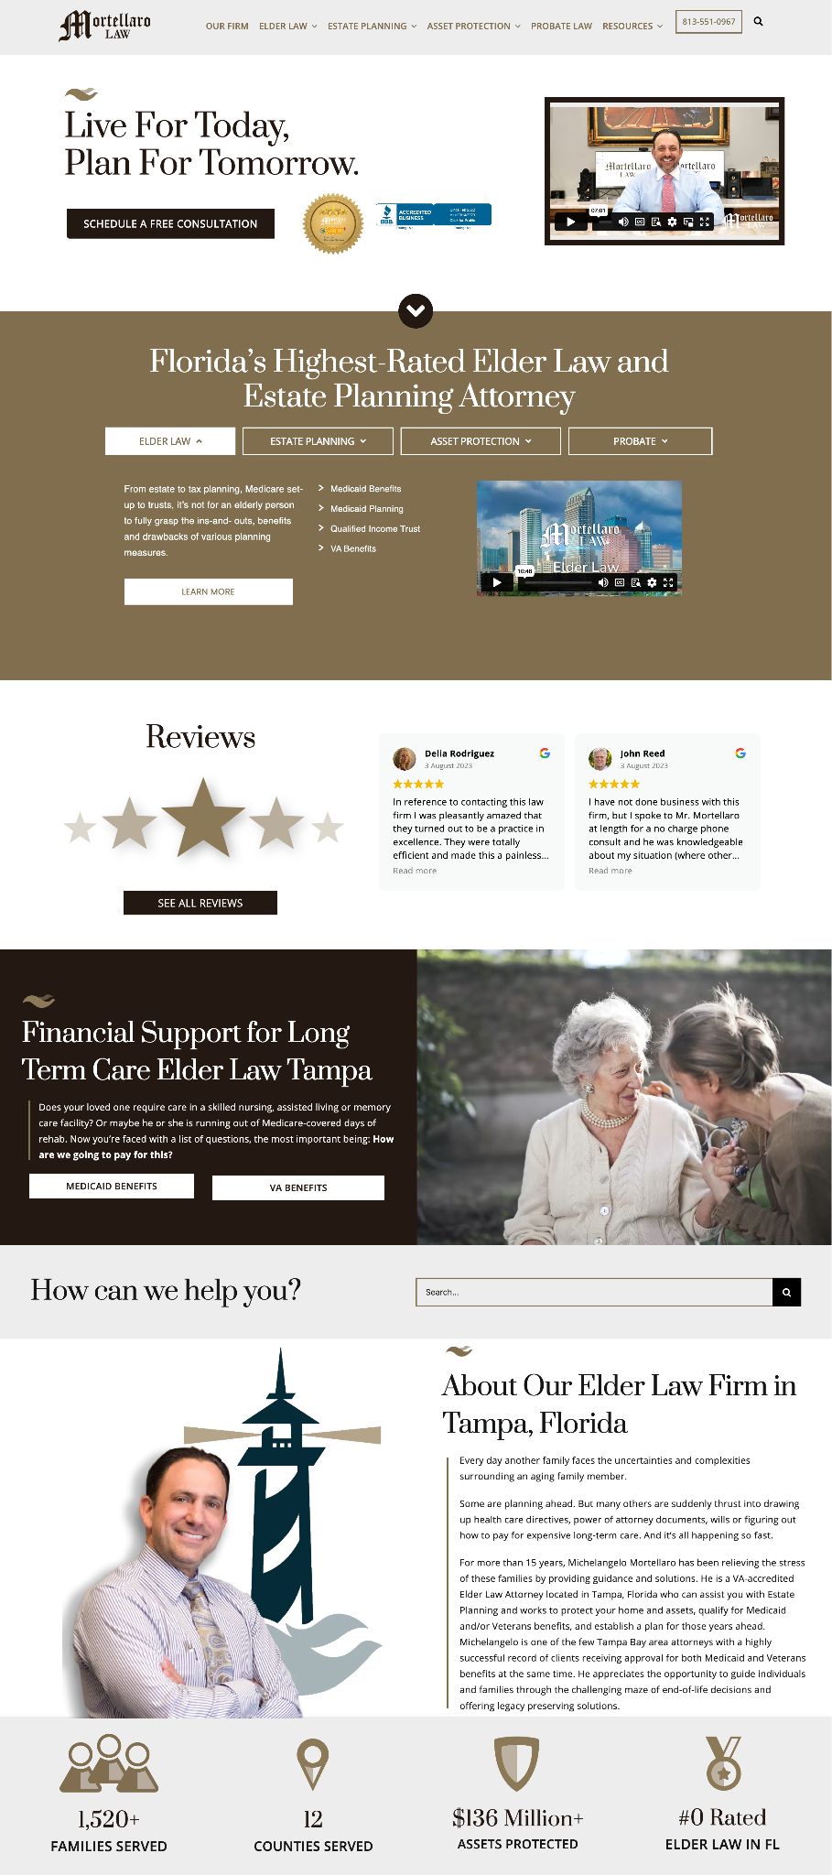
Website Development
Examples of Our Work:
MortellaroLaw.com
Scottrentscharleston.com
Urbannirvana.com
Nationalfleetgraphics.com
Landryfamilydentistry.com

Slide 13
Website Development Includes:
CUSTOM WEBSITE BUILD | Develop on a Wordpress CMS Includes Designing core pages (Home Page, Service Page, About Us, and Contact) using client branding
PAGE CONTENT MIGRATION AND SETUP | Page content, Images, and URL structure will be migrated Content will be reformatted with new look and design.
CONTENT & IMAGES | Images and content transfer from existing platform *Additional Images/Stock Photos not included, *Client responsible for all content
BUILD FEATURES (INCLUDED BUT NOT REQUIRED) | Website Build will include contact form w/ email deliverability setup, click to call links, map, favicon, and social media cards
RESPONSIVE DESIGN AND FUNCTION | Includes formatting and responsive design testing for all mobile devices
POST LAUNCH MIGRATION AND QA | Will migrate completed database and files on requested server and provide post quality assurance test.
USER SETUP | Will setup all appropriate users and provide up to 2 hours of training for backend navigation and editing
WEB HOSTING | *Web Hosting NOT included, $149/month on dedicated secure server

Slide 14
Website Development
Timeline & Deliverables
Website Development
Timeline & Deliverables
Creative Planning (1-2 weeks)
Kick-off call to discuss/re-review your brand and goals
Sitemap & Wireframe
Page Template Discussion
​Build Phase I (2-3 weeks)
Creation and build of agreed-upon layout for core page: Home page, Service/Subpage
Necessary plugins/programs added
Build Phase II (2-3 weeks)
Build remaining sub-pages
Blog Post and Blog Page setup
Contact Form w/ spam check and captcha requirements
Screen size testing for fully responsive performance
Review and Revisions
Final Client Review of website on development link
Updates and Revisions as needed or requested
Initial SEO* (1-2 weeks)
Re-coding Site to ensure continued optimization
Clean, SEO-Friendly URLs
Google Compliant Sitemap
Optimization of images, JavaScript, and other files.​
Pre Launch & Post Launch (1 week)
Final Responsive Testing
Confirm Analytics & Forms
Link Testing
Training and Total Control on WordPress. Video/text guides are also provided.
SSL Installation & Security Compliance
Notes:
Third party review website profiles:
Yelp: https://www.yelp.com/biz/scott-properties-of-charleston-mt-pleasant -> no
Zillow: https://www.zillow.com/profile/spofcharleston
BirdEye: https://reviews.birdeye.com/scott-properties-of-charleston-156986378139742
Better Business Bureau: https://www.bbb.org/us/sc/lexington/profile/rentals-by-owner/scott-properties-of-the-midlands-llc-scott-properties-of-charleston-llc-0663-34049633/customer-reviews
NextDoor Mt Pleasant: https://nextdoor.com/pages/scott-properties-of-charleston-mt-pleasant-sc/
Alignable: https://www.alignable.com/mt-pleasant-sc/scott-properties-of-charleston ->no?

Slide 15
Website Packages
*Content not included
*Every website is unique, based on page content, design, and function.
Website Packages | Estimated Turn Around | Rate
Hosting Includes SSL certificate, Dedicated Cpanel, Website Theme and program/plugin updates to keep site running at best performance, & Support | n/a | $149/month
Landing Page | 30 Days | $1,800
5 Page Fast Design | 60 Days | $5,000
Responsive Up To 10 Pages | 60-90 Days | $6,500
Responsive Up To 20 Pages | 90 Days | $8,200
E-Commerce | 90+ Days | Custom

Slide 16
SEARCH ENGINE OPTIMIZATION (SEO)

Slide 17
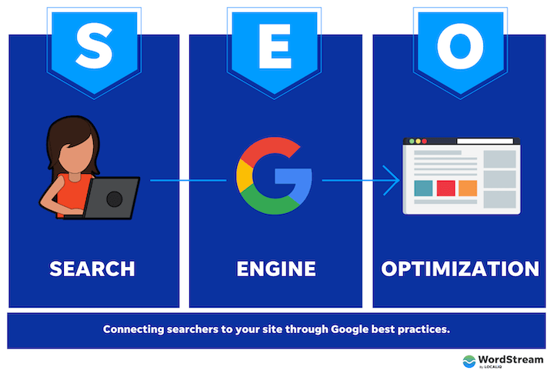
Why is SEO Important?
Search Engine Optimization (SEO) helps your website to appear higher in search engine results pages (SERPs) for relevant search queries.
When people search for something online, they usually only click on the first few results that appear on the SERP. So if your website isn't ranking high in the search results, you're missing out on potential traffic and customers.
By optimizing your website for SEO, you can improve your chances of appearing higher in the search results, which can lead to more traffic and ultimately more business.
This process involves optimizing your website's content, structure, and coding to make it more visible and relevant to search engines.

Slide 18
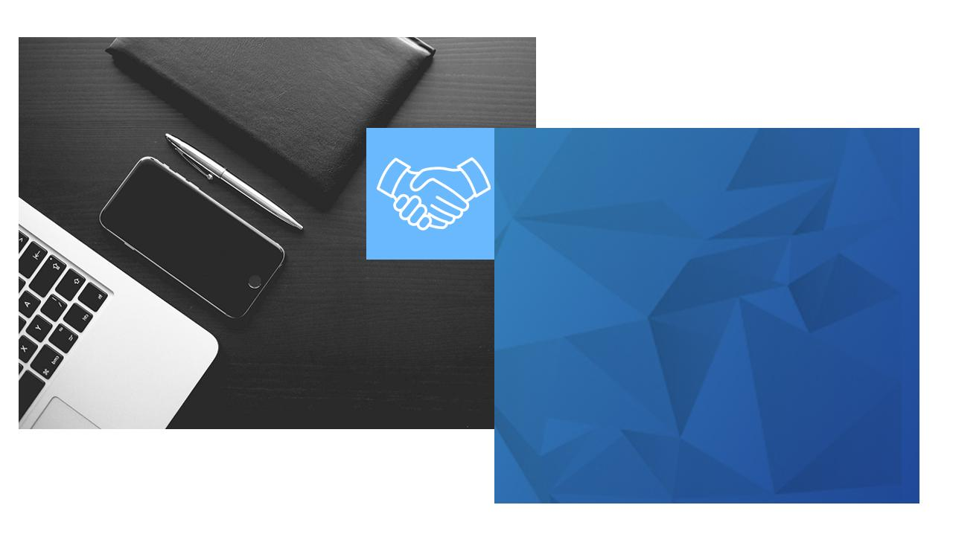
Search Engine Optimization is an encompassing approach to optimize your entire web presence for organic search including your website, social channels, blogs, and directory listings.
We use strategies, techniques and tactics to increase the quality and quantity of organic search traffic to your website with a strong emphasis on content marketing and website performance.
Our SEO services include:
On-Site SEO: Keyword Research, Web Hosting, Google Analytics setup w/ conversion tracking, Internal link building, Proper set-up of meta tags and alt tags, Unique and keyword focused content
Off-Site SEO: Directory Listing Management & Link Building
Helping People Find Your Website

Slide 19
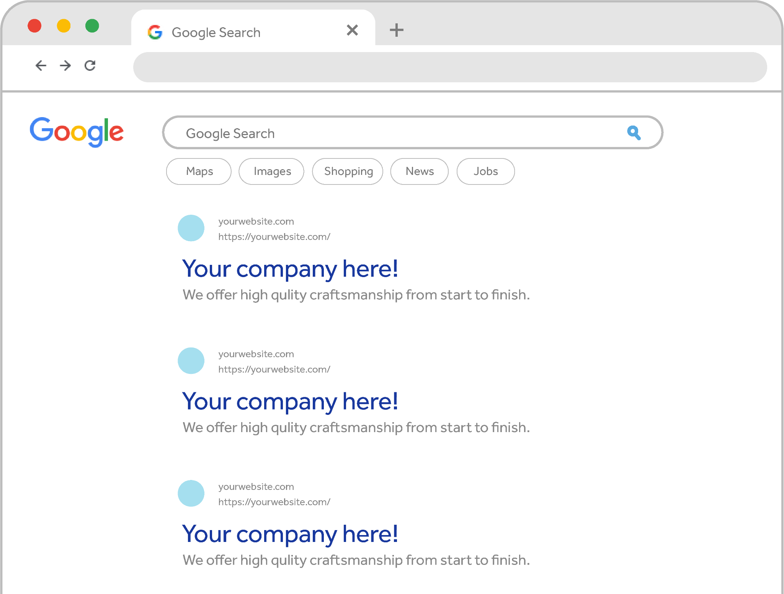
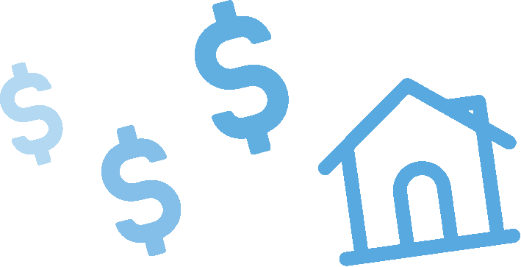
What is SEO?
Think of SEO like
paying rent to Google
to have your website appear in a certain spot on a search results page.
You should view SEO as a business expense, rather than a marketing expense.
Notes:
ANALOGY: paying rent for page 1 on Google Search Engine Results Page

Slide 20
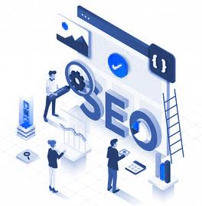
SEO Plans & Pricing
SEO
Local
Regional
Premier
Pricing (Per Month)
$1,800‌
$2,400
$3,600
Search Engine Optimization
Number of Key-phrases Optimized
15
25
40
Plans & Pricing
Short-form content (300 words)
up to 3/month
up to 4/month
up to 5/month
Basic website updates
3 revisions/mo
5 revisions/mo
8 revisions/mo
Additional website pages
$500/page
up to 1 page/mo‌
up to 2 pages/mo‌
Committing to authentic SEO requires a long-term approach that demands time and effort to achieve and maintain a high ranking. It is an achievable goal and the key to success lies in developing a solid plan and consistently implementing it to keep your website optimized and up-to-date.
SEO contracts are 12 months.
Month 1 is Set Up; Month 2-12 program execution.
*Web Hosting Included With SEO Contract.
$149/month for all non-SEO Contracts
*Web hosting on dedicated server
✓
✓
✓
Key-phrase research and selection
✓
✓
✓
Meta tags (title & description)
✓
✓
✓
Optimization of robots.txt & GoogleBot crawls
✓
✓
✓
Creation & registrations of sitemap.xml
✓
✓
✓
Google Analytics setup w/ conversion tracking
✓
✓
✓
Page speed optimization
✓
✓
✓
Custom 404 error page setup and optimization
✓
✓
✓
Directory Listing Management
✓
✓
✓
Updating core files & database
✓
✓
✓
Internal Link Building
✓
✓
✓
Customized monthly reporting
✓
✓
✓
Web lead phone call tracking
✓
✓
Mobile site optimization (if applicable)
✓
✓
Schema HTML tags
✓
✓
Searcher experience analysis (heat map)
✓
Channel specific call tracking
✓

Slide 21
BLENDED

Slide 23
LIVE CHAT

Slide 28
VIDEO

Slide 29
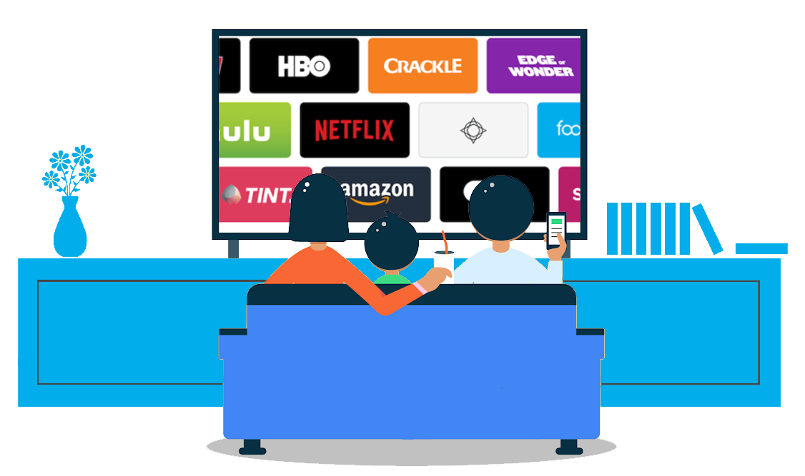
What is OTT (Over The Top)?
CTV & OTT - Video Advertising
An “over-the-top” media service is any online content provider that offers streaming media as a standalone product. The term is commonly applied to video-on-demand platforms, but also refers to audio streaming, messaging services, or internet-based voice calling solutions.
Here are just a few reasons why the format is more appealing than traditional alternatives:
1
Targeting your key audience in their homes while streaming their favorite shows is a valuable opportunity. Millions of Americans are leaving cable TV behind and moving to CTV & OTT entertainment. This provides an ever growing advertisement opportunity for businesses around the country to reach new customers.
2
Compatibility with multiple devices: This provides ample opportunity to reach people wherever they are streaming their favorite shows. For years, watching cable television required a television set. Today, we can watch CTV & OTT content from a broad range of devices. Any account holder can enjoy the same CTV or OTT experience from a gaming console, smartphone, tablet, or smart TV.
What is CTV (Connected TV)?
Connected TV specifically refers to televisions that have access to an internet connection and can load or stream digital content. This mainly includes Smart TVs (where internet connection is built-in).
Why CTV & OTT Advertising?
With over 50% of North Americans maintaining Netflix subscriptions, it’s clear consumers love CTV & OTT content.

Slide 30
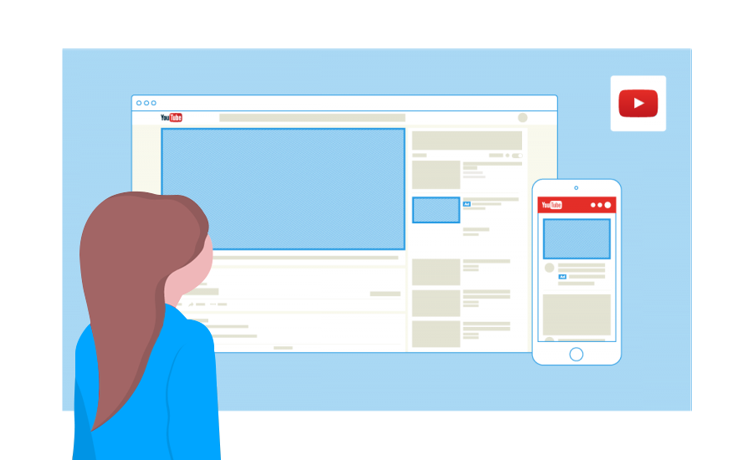
Reach Your Customers – And Find New Ones
Foodies down the block. Fashionistas across the country. YouTube connects you to the people who matter most to your business.
Grow your business with YouTube Ads.
Reach potential customers where they're watching.
2X
70%
4X
Show Up When It Counts
Turn viewers into customers, on any budget. YouTube Ads uses Google data to match your message to the right people at the right moment.
Viewers say they’re 2x more likely to buy something they saw on YouTube.
Over 70% of viewers say that YouTube makes them more aware of new brands.
Viewers are 4x more likely to use YouTube versus other platforms to find information about a brand, product, or service.
See The Results You Want
YouTube Ads make it easy for people to choose your business. Get more purchases, subscribers, website visits, and more.

Slide 32
EMAIL BLAST

Slide 33
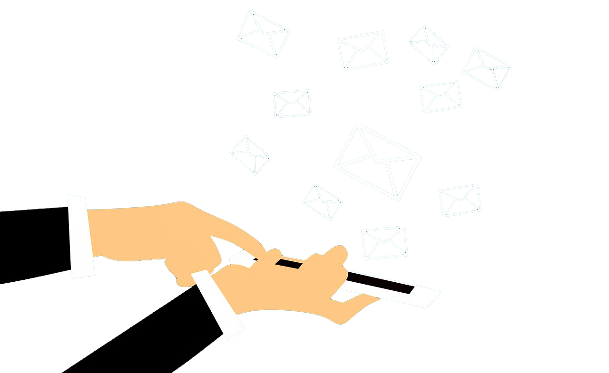
Email Blast
WHAT?
A digital marketing strategy is used to send emails and develop relationships with prospects and customers. An effective email marketing strategy converts prospects into customers, and turns first time buyers into recurring customers.
WHY?
According to Optinmonster, 58% of people check their email before social media. in fact, businesses that use email marketing as a way to communicate with their audience make triple the amount of revenue as a business owner who does not.
• Higher guaranteed click through rate • Additional traffic to your website • Increased conversion rates • Easy-to-understand analytics and reporting • Hyper-target your audience where they are engaging most • Connect with an audience that has expressed brand interest • 500+ Data Qualifiers to target for the outbound email marketing
TARGETING OPTIONS
GeoGraphic:
City, County, Zip Code
PyschoGraphic:
Habits, Hobbies, Values
DemoGraphic:
Age, HHI, Credit, Etc.
Behavioral:
Website Visits, Search Terms

Slide 34
AUDIO STREAMING

Slide 36
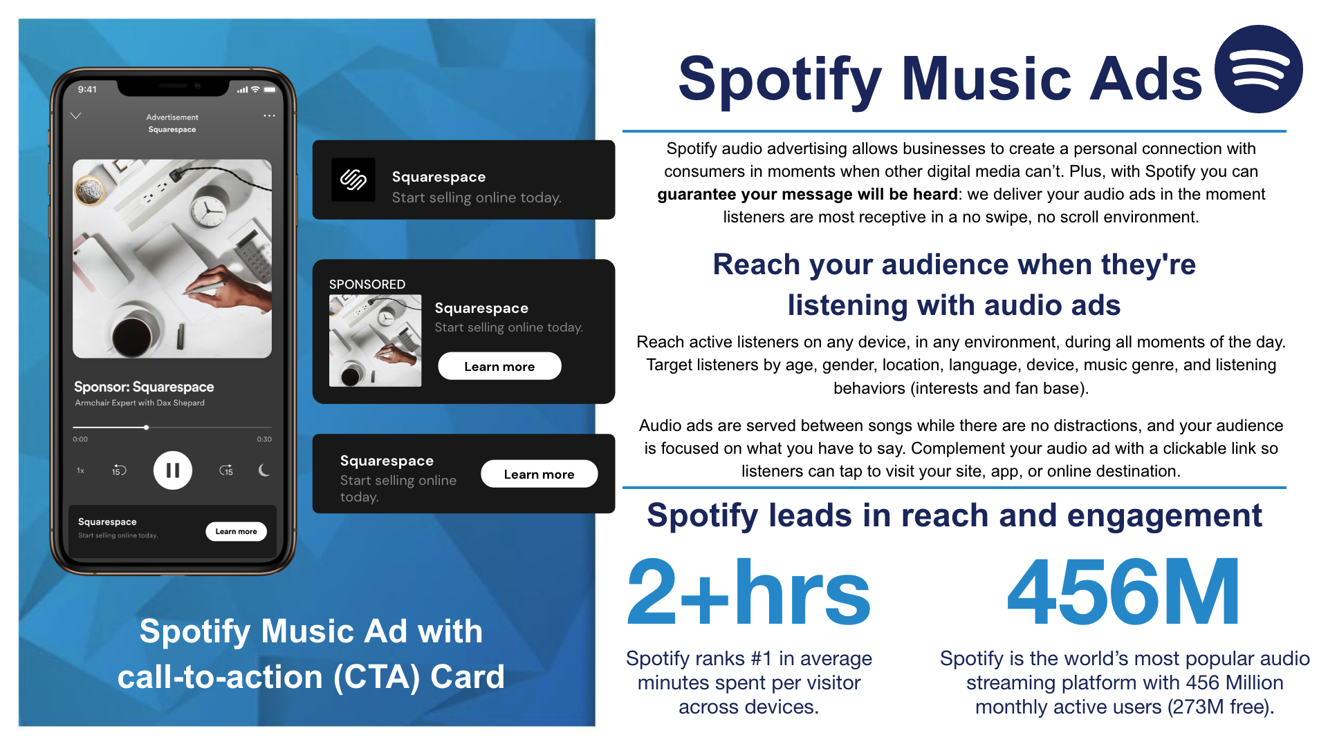

Slide 37
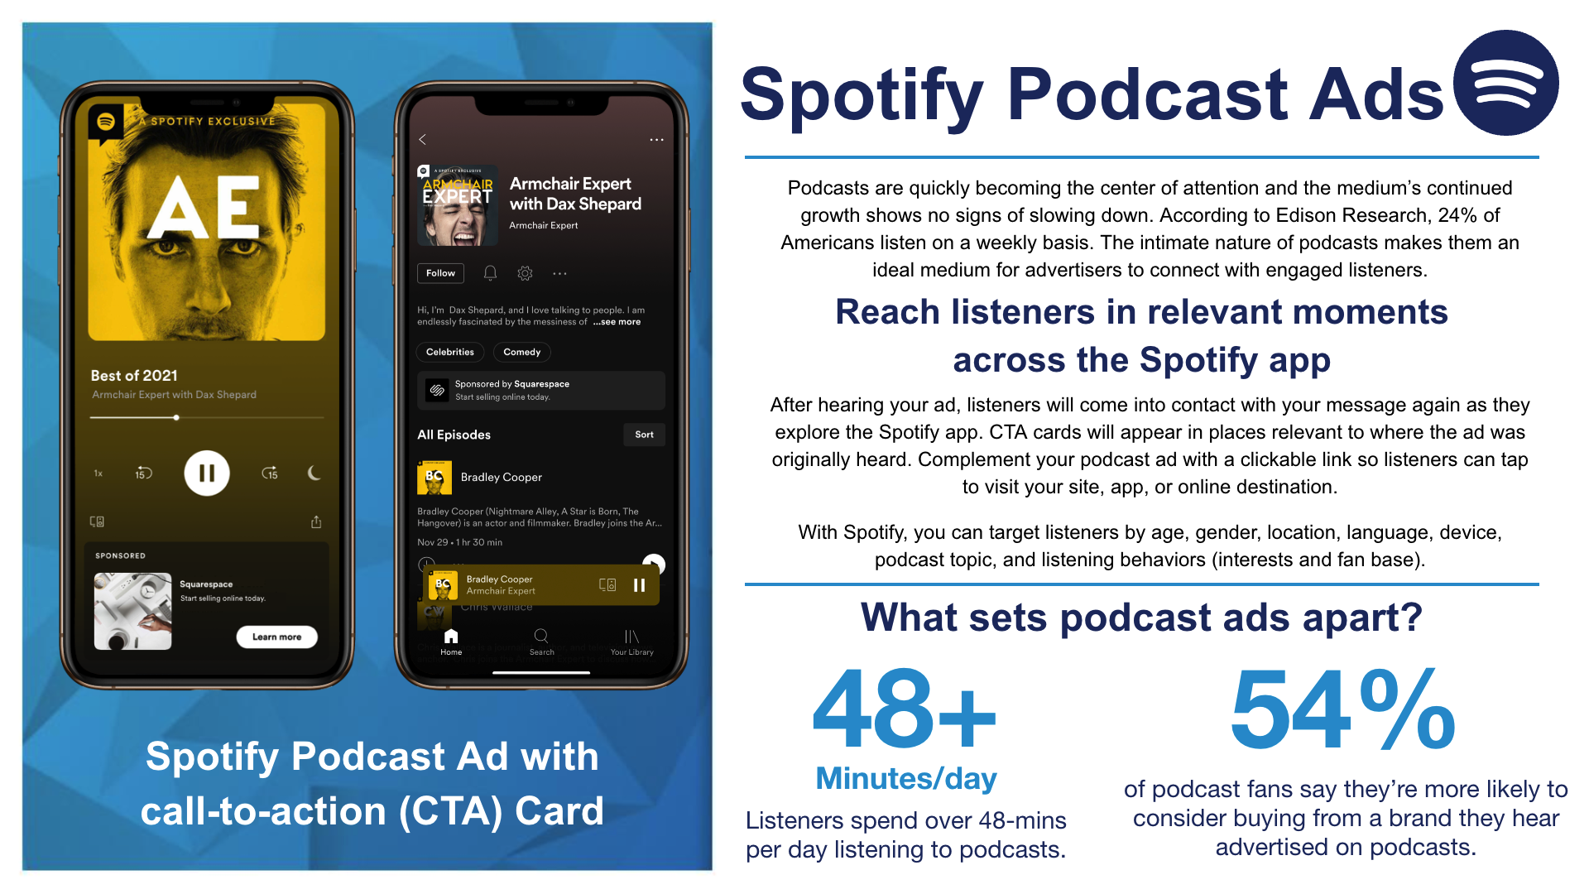

Slide 38
SOCIAL MEDIA

Slide 39
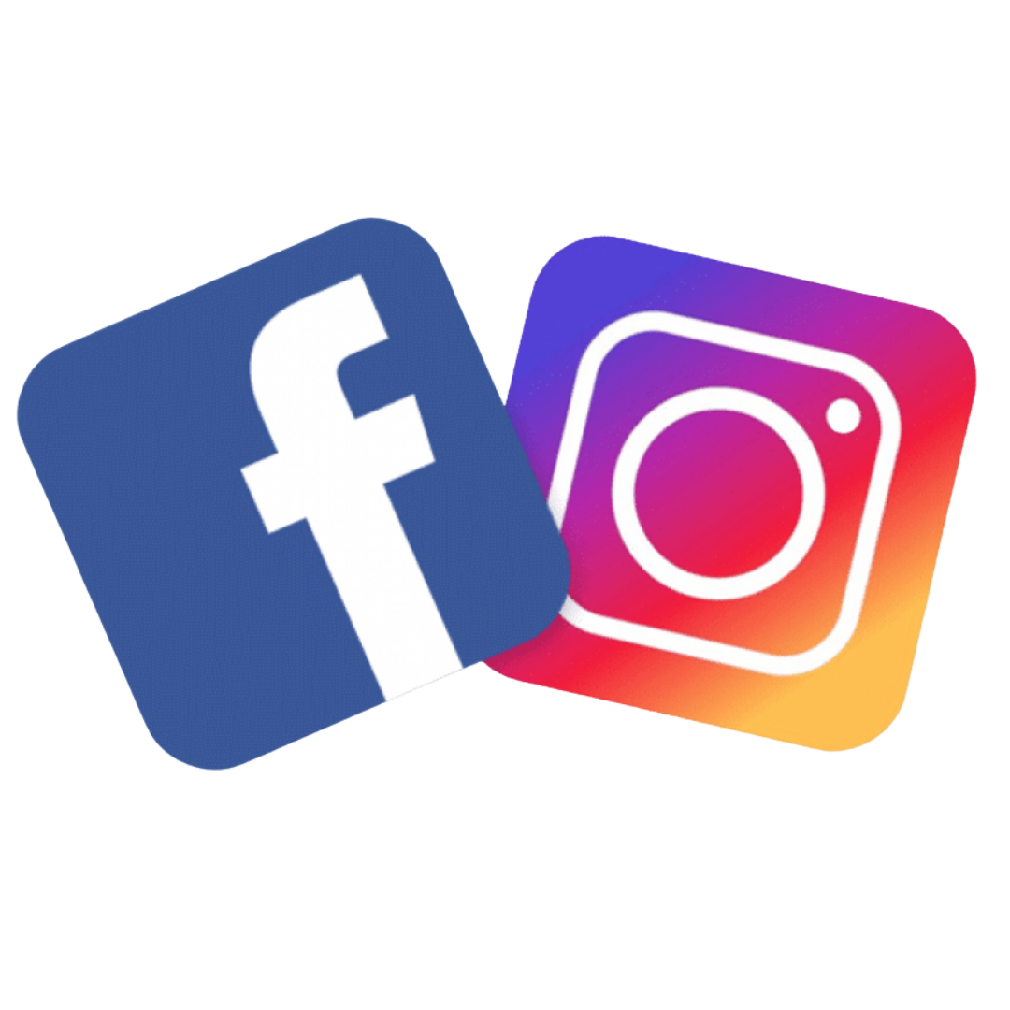
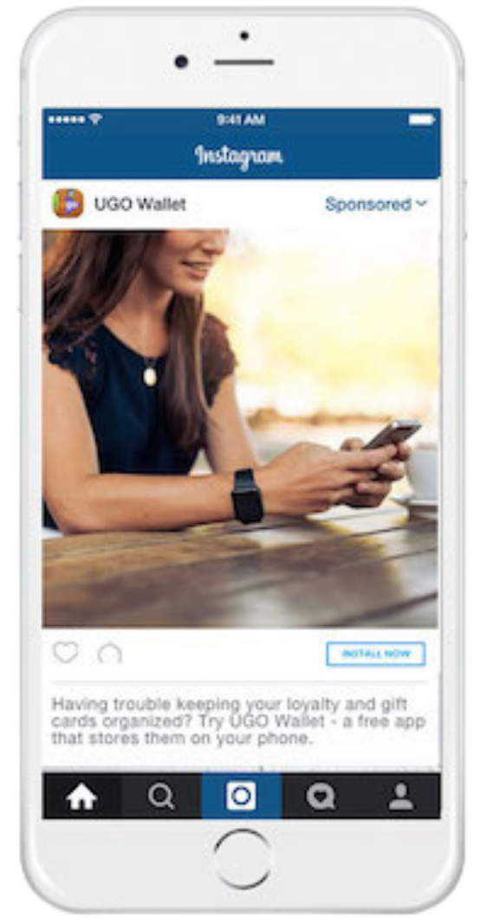
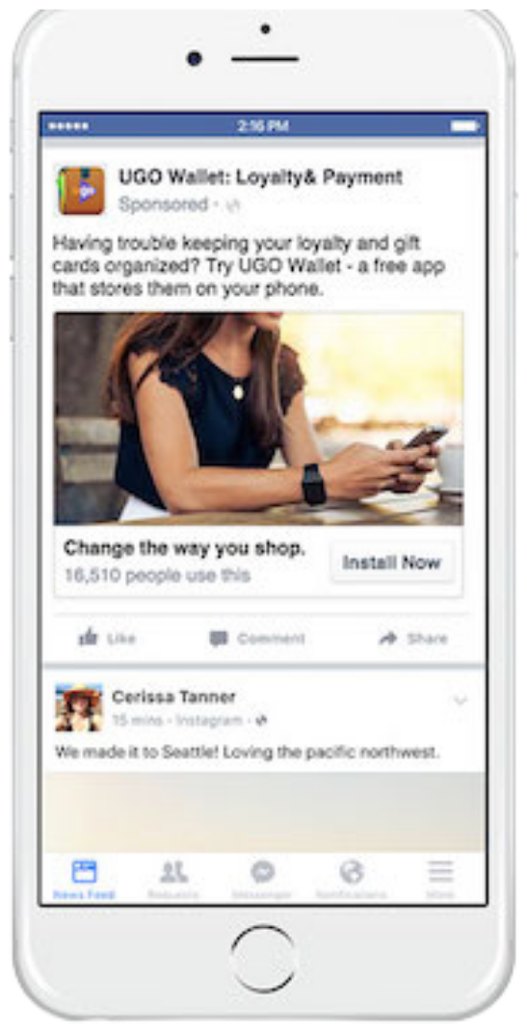
Promote your business with
Facebook & Instagram ads
Reach your ideal customers on two of the most popular mobile platforms.
Advertising on Facebook & Instagram helps businesses of any size achieve their goals.
Campaigns that ran across both Facebook and Instagram resulted in similar or better performance for website clicks, website conversions, video views and mobile app installs than those that ran on just one.
Facebook and Instagram campaigns can use the same photos or video across both platforms or unique creative for each.
1 in 5
How Facebook & Instagram
ads Targeting Works
One in five minutes on mobile is spent on Instagram or Facebook. That’s more than the next 10 mobile platforms combined!
Facebook will automatically show your ads to people who are most likely to find your ads relevant. You can further target your ad delivery with three audience selection tools.
Core Audiences
Custom Audiences
Lookalike Audiences
Define an audience based on criteria like age, interests, geography and more.
Get back in touch with people who have engaged with your business, online or off.
Reach new people whose interests are similar to those of your best customers.

Slide 40
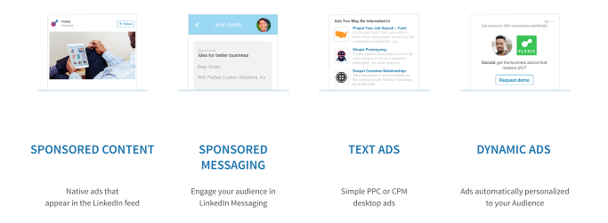
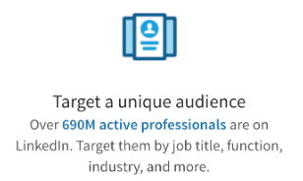
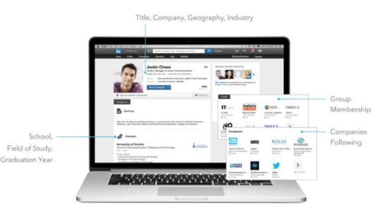
Promote your business with LinkedIn ads
Reach your ideal customers on the world's largest professional network.
Advertising on LinkedIn helps businesses of any size achieve their goals.
How LinkedIn ads Targeting Works

Slide 41
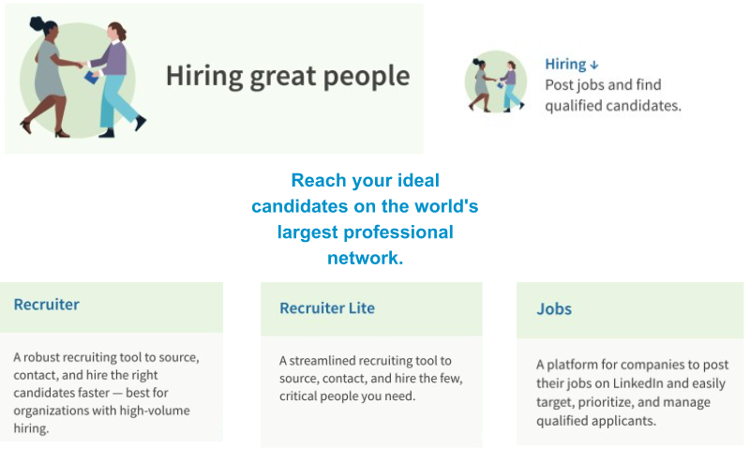
Promote your business with LinkedIn ads
Ensure your open roles get in front of relevant candidates with LinkedIn Jobs. LinkedIn Jobs gives you access to the largest global network of professionals on LinkedIn -- where over 50 million job seekers search for jobs every week. When you pay to promote your open roles, you can get an average of 3x the amount of qualified candidates in your pipeline.

Slide 42
TARGETED DISPLAY

Slide 43
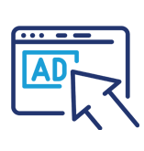
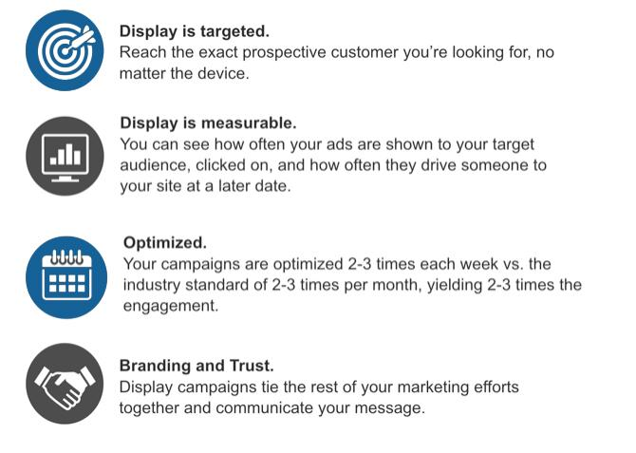
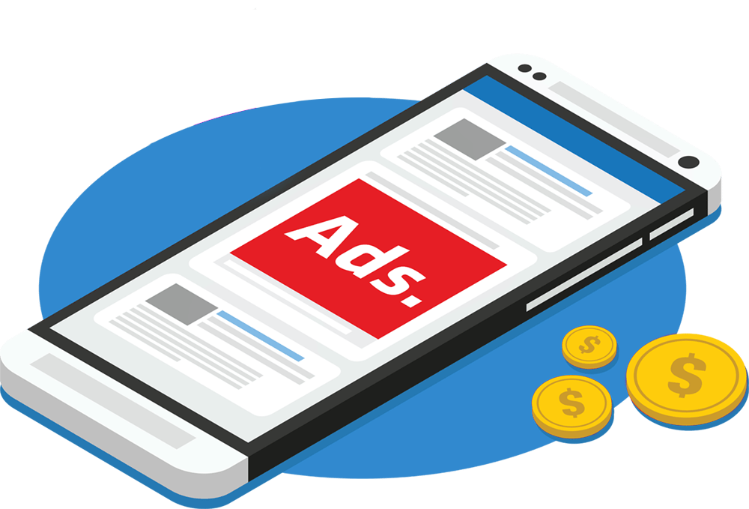
Display Advertising
Brand your business and build awareness of your programs to the consumer as they live out their digital lives online.
Reach more people in more places online.
Display ads can help you promote your business when people are browsing online, watching YouTube videos, checking Gmail, or using mobile devices and apps.
Target people anywhere, anytime, on any device.
• Mobile/Desktop • Dynamic • Geographic • Retargeting • Native
• Demographic • Behavioral • Category Contextual • Keyword Contextual • CRM Targeting

Slide 44
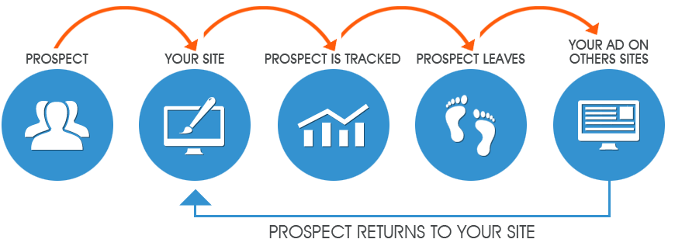
Retargeting
Benefits of remarketing to prospective customers with retargeting ads
Well-Timed Targeting: Show your ad to people who've previously interacted with your business right when they are searching. Focused Advertising: Create custom remarketing lists for specific cases. Ex, people who left their shopping cart. Large-Scale Reach: The users are served ads from the addressable geo-fencing campaign Efficient Pricing: You can create high-performance campaigns with automated bidding for the optimal bid in real time. Valuable Statistics: Reporting on how your campaign is performing based on visitors returning to your site.
26% Potential Increase in Conversion Rate after retargeting visitors
Retarget potential customers that have visited your website.

Slide 45
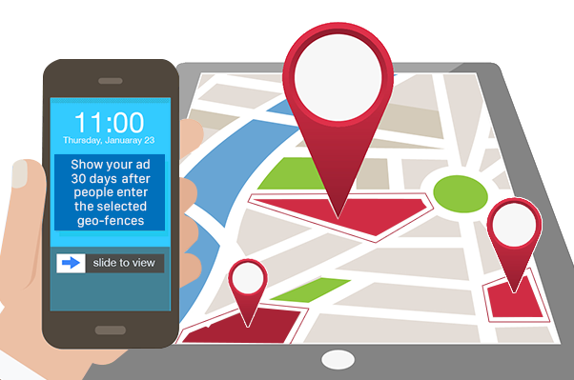
Geo-Fencing
Brand your business and build awareness of your programs to the consumer as they live out their digital lives online.
How Does Geo-fencing Work?
Step 1: A virtual boundary is drawn around a physical location.
Step 2: A user enters the geo-fenced location.
Step 3: The user is served ads from the geo-fencing campaign for up to 30 days
Benefits of Geofencing
Geo-fence technology enables you to capture audiences through custom targeting shapes around businesses, street and highway boundaries, municipalities, etc. • The most reliable way to target mobile users in your business’s proximity • Pinpoint accuracy • Granular localization via custom shapes & sizes • Boost mobile performance and reach • Retarget customers who visit or commute through any geo-fenced location • Track off-line or “last mile” conversions to measure your campaign’s effectiveness • Leverage targeted campaigns only to customers within a predetermined physical proximity to your business or your competitor’s business

Slide 46
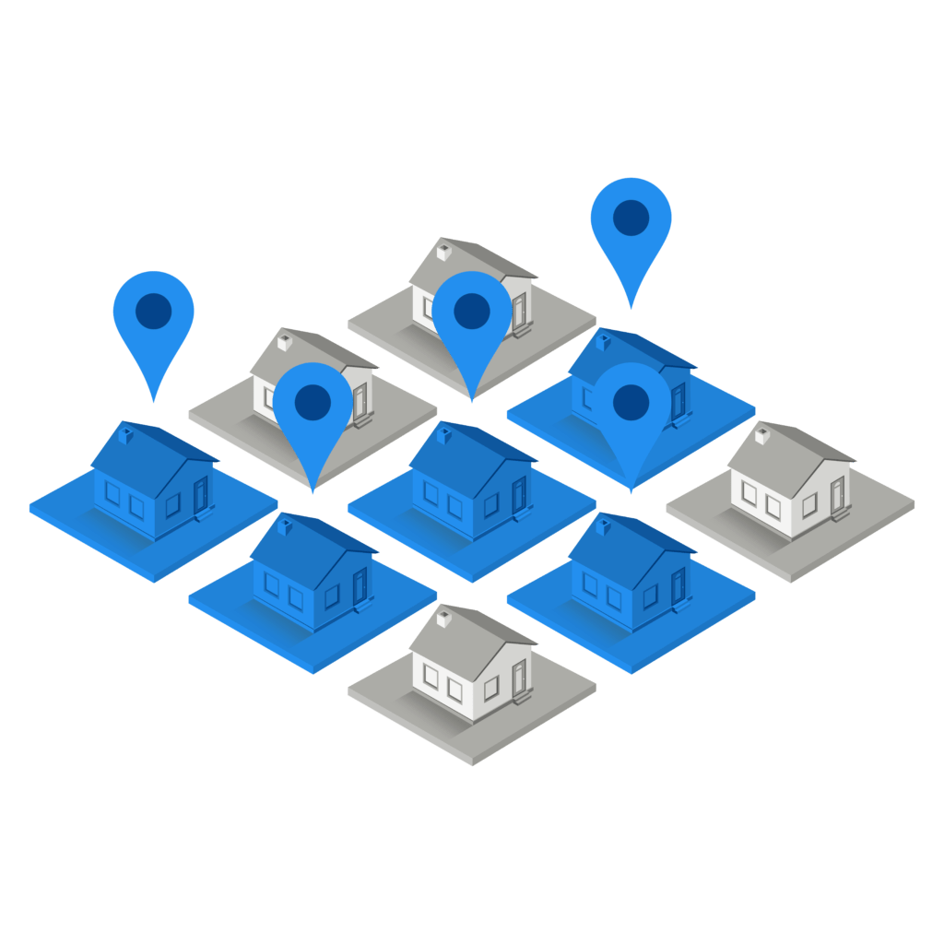
Addressable Geo-Fencing
Brand your business and build awareness of your programs to the consumer as they live out their digital lives online.
How Does Addressable Geo-fencing Work?
Step 1: Target your mailing list OR build a curated list based on demographic targeting
(zip code, household income, credit score quartile, etc.)
Step 2: Devices are captured at the address using platline data
Step 3: The users are served ads from the addressable geo-fencing campaign
Benefits of Addressable Geofencing
Addressable Geo-fence technology offers: • The most reliable way to target users on various devices in your target demographic • Pinpoint accuracy & localization via platline data • Anticipated 90% match rate for mailing lists​ • Retarget customers/prospects on your mailing list • Foot traffic attribution to measure your campaign’s effectiveness • Cross device execution

Slide 47
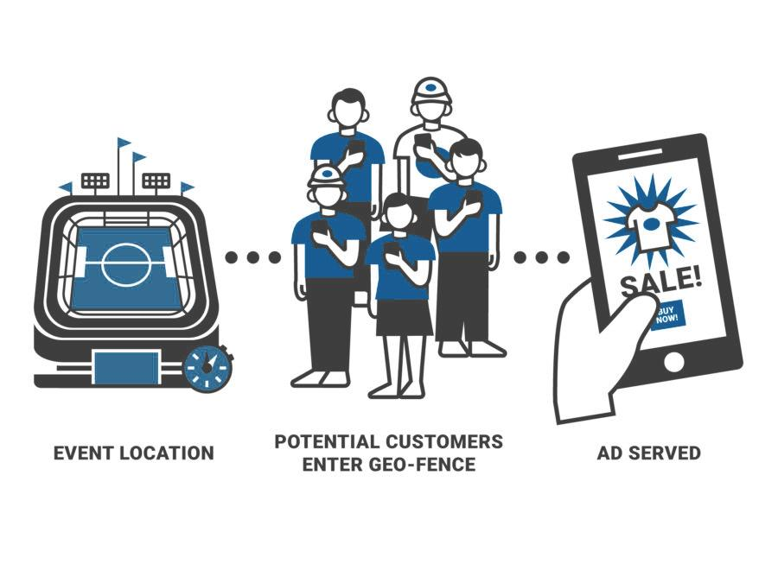
Event Geo-Fencing
Brand your business and build awareness of your products/programs to the consumer as they live out their digital lives online.
How Does Event Geo-fencing Work?
Step 1: A virtual boundary is drawn around a physical location for a specific period of time.
Step 2: A user enters the geo-fenced location.
Step 3: The user is served ads from the geo-fencing campaign for up to 30 days
Benefits of Event Geofencing
Event geo-fence technology enables you to capture audiences through custom targeting shapes around concerts, sporting events, conventions, and other event types. • The most reliable way to target mobile users at specific events • Pinpoint accuracy • Granular localization via custom shapes & sizes • Boost mobile performance and reach • Retarget customers who attend an event • Track users who visit your store after seeing an ad to measure campaign effectiveness

Slide 48
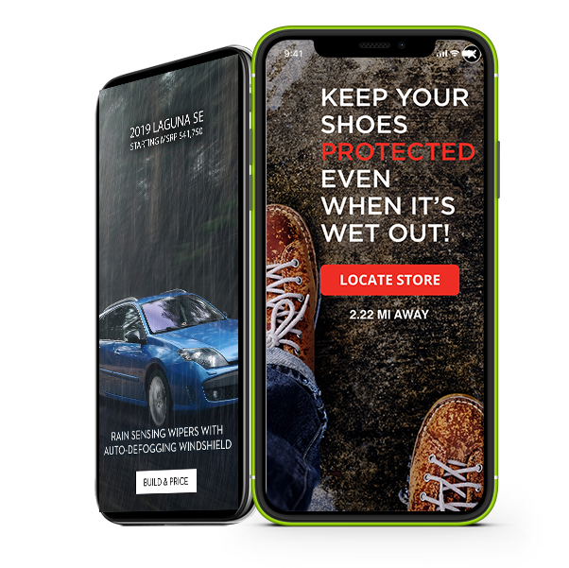
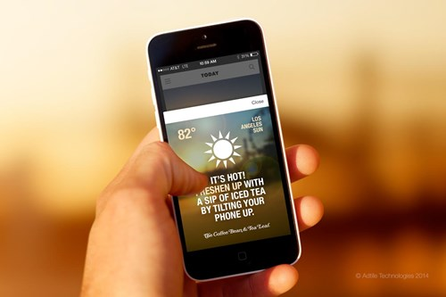
Weather Trigger
Weather ads target based on the current weather and the forecasted conditions. Combined with location data, weather triggers allow marketers to provide the most contextual, relevant and tailored message to customers and tap into consumers’ moods, desires and purchase intent at any given moment and location.
We Can Schedule Ads to Run Based On:
Weather Alerts
Forecasted Conditions
Severe Wx Watches and Warnings
UV Index
And So Many More Weather Conditions
Creative Ad Examples:
Rain Targeted Ad
Snow Targeted Ad
Heat Targeted Ad

Slide 49
BUDGET ALLOCATION

Slide 50
Campaign Details
 | Option 1 | Option 2 | Option 3
Tactic 1 | $ | $ | $
Tactic 2 | $ | $ | $
Tactic 3 |  | $ | $
Tactic 4 |  |  | $
Tactic 5 |  |  | $
TOTAL | $ /month | $ /month | $ /month

Slide 51
Thank You
[Client Logo]

